Slide 1
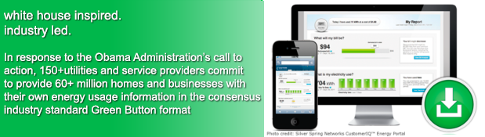
The Green Button Initiative
www.greenbuttondata.org
John Teeter, john.teeter@nist.gov
Marty Burns, martin.burns@nist.gov
Smart Grid and Cyber-Physical Systems Program Office Engineering Laboratory, NIST

Slide 2
Green Button Technology
– Consistency
– Interoperability
– Scaling to Market

Slide 3
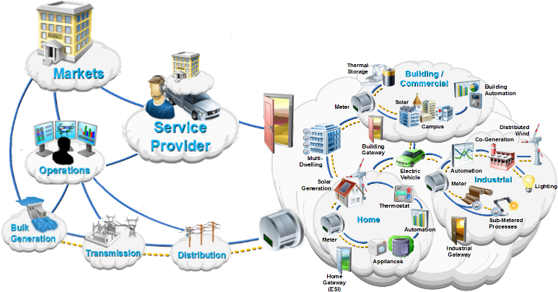
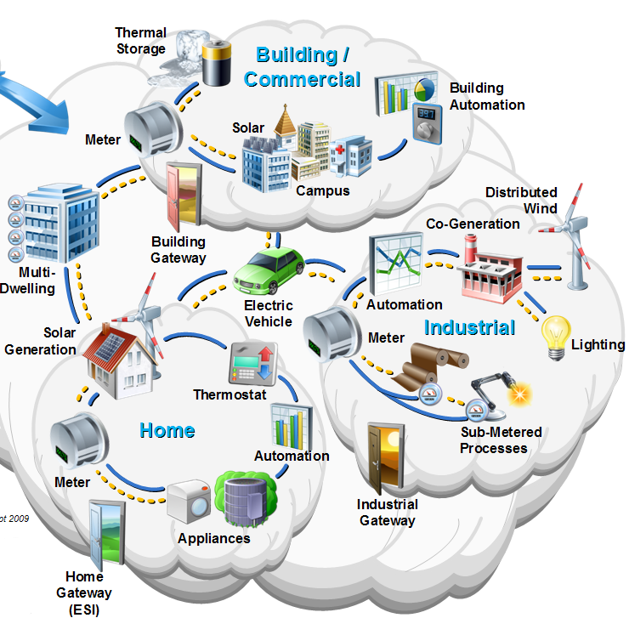
Customer Domain
Wholesale
Customer Domain
Retail
Markets

Slide 4
Current Status
Green Button XML representation is stable. Review it at: Ref: espiDerived.xsd
Download My Data Testing and Certification is ready.
Validate your XML Data
Review the DMD Test Plan
Connect My Data implementations are underway. Implementation Agreements:
GreenButtonAuthorization.docx
GreenButtonAtomLinks.docx
espiDerived.xsd
Green Button Sandbox
https://services.greenbuttondata.org
Deploy your own sandbox
Open Data by Design Challenge ($17,000 in Prizes)

Slide 5
Definitions
EUI - One or more components of energy usage information including UsagePoint, MeterReading, IntervalBlock, ReadingType, LocalTimeParameters, ElectricPowerUsageSummary, and ElectricPowerQualitySummary
ApplicationInformation - A single data structure that contains definitions of all information shared between a Data Custodian and Authorized Third Party that govern their communications relationship.
Authorization - A single data structure that represents the three-party agreement between Retail Customer, Data Custodian, and Authorized Third Party which covers the life of the authorization for EUI exchange.
Ref: GreenButtonAuthorization.docx Section 1.1

Slide 6
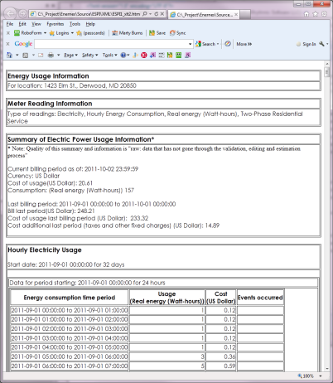
Diversity of information in EUI
Measurements of power, energy, gas, water, …
Quality: Raw, validated, estimated, …
Source: Meter near real-time, utility back end, third party
Economics: Consumers need to know the cost of their consumed power (but we did not construct a pricing model)
Identification: by customer, device, location
Dimensions
Kinds of Data
Readings
Interval data
Summary Information
Power Quality Metrics

Slide 7


Green Button Data Exchange
Data Custodian
Third Party
Third Party Registration
Web Service Provider
Web Service Consumer
Automated Transfer
Web Portal
One-time Authorization
Web Portal
Retail Customer
User (agent)

Slide 8
Green Button Connect My Data

Slide 9
Green Button Sandbox
Open source implementation
RESTful API functions
Determined by “Function Block”
Focus today on Batch transfers
Services.greenbuttondata.org
Individual Retail Customer Accounts – single and multiple Usage Points
Portfolio of Accounts⁽¹⁾
Scope Parameters⁽¹⁾
Making a private sandbox
Download/Run the Virtual Machine
Clone/Build/Run the Github repositories
Deploy the Amazon Machine Image (AMI) ⁽¹⁾

Slide 10
Third Party Perspective
Registration of Third Party ⬅⬅
Manual and not yet standardized
Each Data Custodian will have unique process
Moving toward OAuth2 Dynamic Client Registration
Authorization of Data Access
Individual Retail Customer Accounts – single and multiple Usage Points
Scope Parameters
Portfolio of Accounts
Process of Data Exchange
Notifications
OAuth2 access_tokens
Pull Scenarios

Slide 11
Registration of Third Party
Manual and not yet standardized
Relationship between Data Custodian and Third Party
Information captured in ApplicationInformation Resource
Updates and Termination
Each Data Custodian will have unique process
May involve manual steps
Accountability and Validation
Collecting ApplicationInformation data
Moving toward OAuth2 Dynamic Client Registration
Not yet IETF RFC – Working Draft
Rapid movement to support when ratified
Open source implementation soon

Slide 12
ApplicationInformation
A p p l I c a t I o n I n f o r m a t I o n
PG&E
ThirdParty 1
SCE
ThirdParty 2
SDG&E
ThirdParty N
DataCustodian M
Each Relationship shares an
ApplicationInformation Resource

Slide 13
ApplicationInformation
The result of the registration process is the creation of an ApplicationInformation object (with @40 Attributes)
A shared view of the capabilities and relevant endpoints maintained by both parties (the contract b/t the actors)
Updates and access (via RESTful https requests) are available. (manageable for dynamic configuration)
Detail in references
Ref: Authorization.docx Appendix D
Ref: espiDerived.xsd

Slide 14
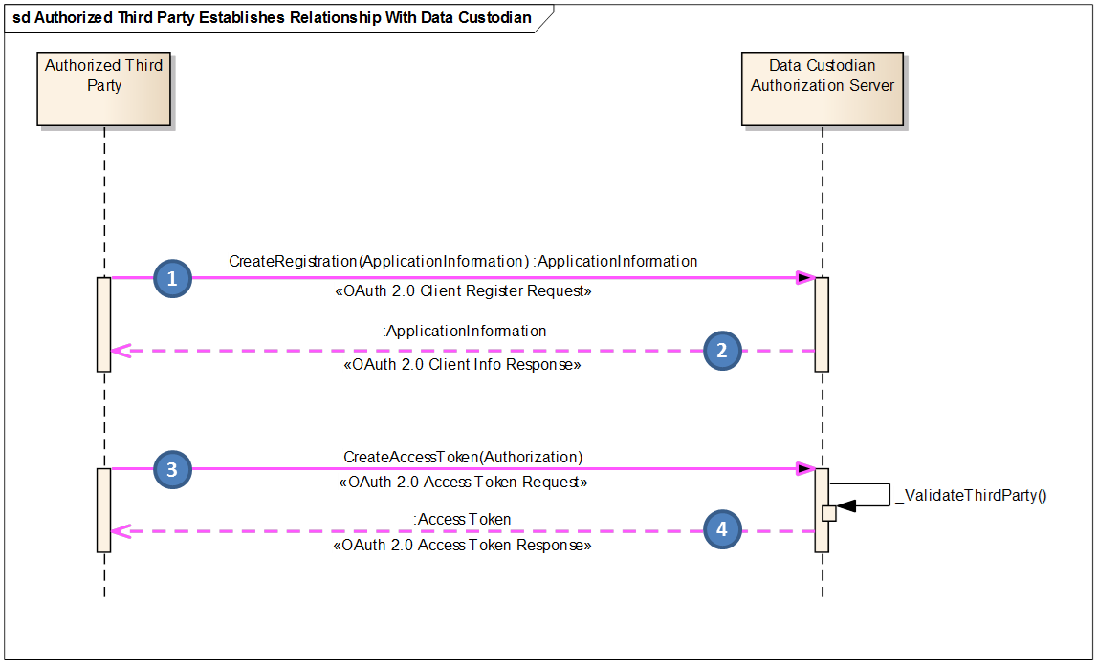
Green Button Connect My Data Registration
Ref: Authorization.docx Section 2.2

Slide 15
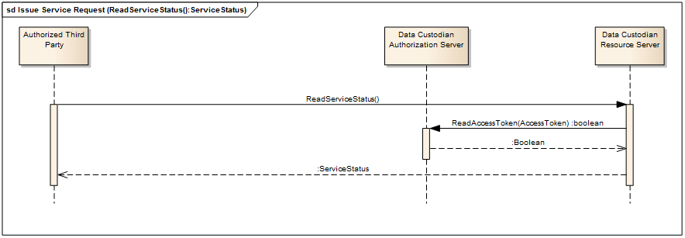
Green Button Connect My Data Status and Notification
Status Codes:
0 = Unavailable
1 = Normal
Authorization: Bearer {client_access_token}
Ref: Authorization.docx Section 2.2.2

Slide 16
Third Party Perspective
Registration of Third Party
Manual and not yet standardized
Each Data Custodian will have unique process
Moving toward OAuth2 Dynamic Client Registration
Authorization of Data Access ⬅⬅
Individual Retail Customer Accounts – single and multiple Usage Points
Portfolio of Accounts
Scope Parameters
Process of Data Exchange
Notifications
OAuth2 access_tokens
Pull Scenarios

Slide 17
Authorization of Data Access
OAuth2 Authorization Patterns
Using client_credential and authorization access codes
OAuth2 scope negotiation
Authorization of Data Access
Single Retail Customer/UsagePoint
Message Patterns
Scope Parameters
Scope parameter details
Resource Terms
Function Blocks supported
Kinds of Data (Intervals, durations, …)

Slide 18
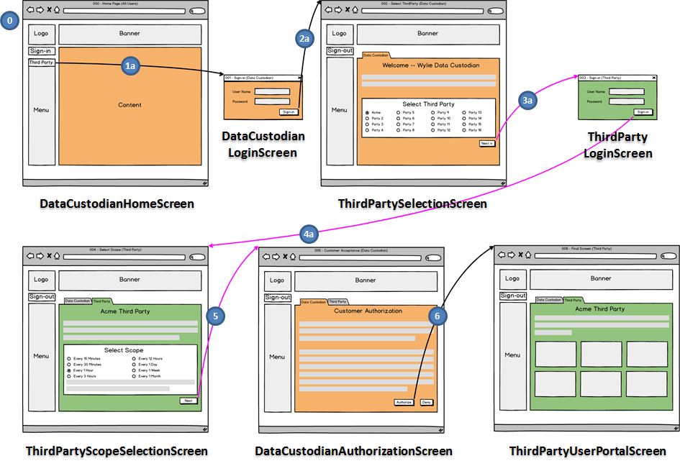
Green Button Connect My Data User Experience Guidelines
Ref: Authorization.docx Section 2.3.2

Slide 19
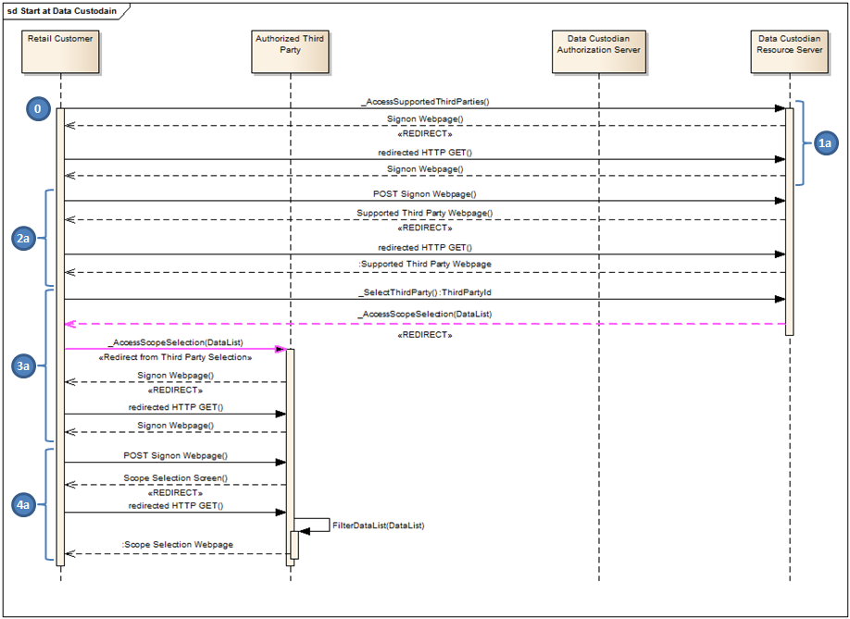
Green Button Connect My Data RetailCustomer Authorization
Ref: Authorization.docx Section 2.3.2

Slide 20
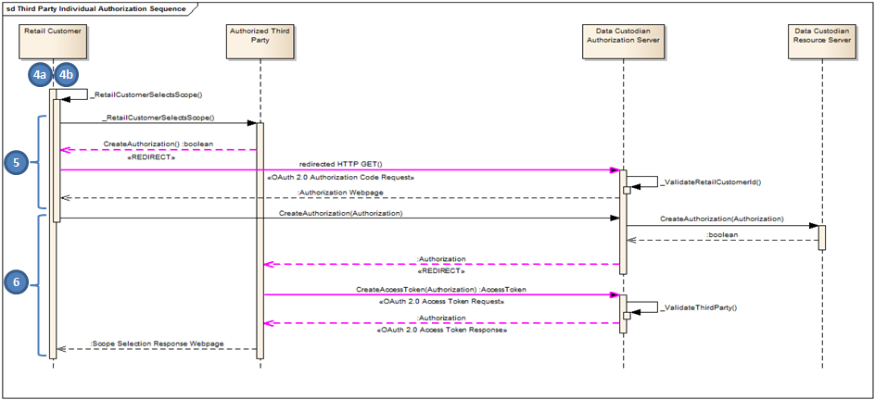
Green Button Connect My Data RetailCustomer Authorization
Ref: Authorization.docx Section 2.3.2

Slide 21
Access Tokens Obtained
access_token: allocated by datacustodian for individual account authorizations
refresh_token: allocated at the time of authorization and used to renew an access_token
Note that access tokens are entirely under the control of the Data Custodian which can determine the life cycle of the access tokens and refresh tokens. The Authorized Third Party is required to react to the changes in the access token and/or refresh token as they occur.
Use:
GET {ResourcePath}<resource>/{ResourceID} HTTP/1.1
Host: {ResourceServer}
Content-Type: application/atom+xml
Authorization: Bearer {AccessToken}
Ref: Authorization.docx Section 1.2.2

Slide 22
Portfolio and Multiple Accounts
Work is currently underway: OpenADE
To extend the information model
Insure PII integrity of ESPI
PII Containing information
Subscription
Anononymous EUI
RetailCustomer
UsagePoint
ServiceLocation
Customer Agreement
Normal ESPI
Resources
EndDeviceAsset
ServiceSupplier
PositionPoint
Key
TariffProfile
Authorization
New Resource
Existing Resource
*This data structure is to be developed on an aggressive schedule based on HelpDesk issue #83 and PAP10 NAESB Std REQ.18. No single API request can retrieve both PII and Anonymous data
Non-Resource Class
Ref: OpenADE Meeting Notes: Slide 05

Slide 23
Example Scope String
Scope = “FB=1_3_4_5_8_13_18_19_31_34_35_39; IntervalDuration=900_3600;BlockDuration=Daily; HistoryLength= 34128000;SubscriptionFrequency=Daily; AccountCollection=5;BR=1;”
Identifying which Function Blocks
Looking at 15 min and 1 hour interval data blocked daily
An initial history of 13 months, with daily feed
When doing bulk (using bulkId = 1) there will be 5 usage points in the transfer
Ref: Authorization.docx Section 2.6
Ref: GreenButtonCMDWorkshop: Slide 04

Slide 24
Examples for Connect My Data
Example Scope Strings ^{(* subject to change)}
SCE^{(*)}
Scope = “FB=1_3_4_5_8_13_18_19_31_34_35_39; IntervalDuration=900_3600;BlockDuration=Daily; HistoryLength= 34128000;SubscriptionFrequency=Daily;  AccountCollection=5;BR=1;”
PG&E^{(*)}
Scope = “FB=1_3_4_5_7_8_13_14_15_18_19_31_32_34_35_37_38_39_40; IntervalDuration=300_900_3600;BlockDuration=Daily_BillingPeriod_Weekly_Monthly; HistoryLength=63072000;SubscriptionFrequency=Daily;  AccountCollection=5;BR=1;”
SDG&E^{(*)}
Scope = “FB=1_3_4_5_8_13_14_18_19_31_34_35_39_40; IntervalDuration=300_900_3600;BlockDuration=Daily_BillingPeriod_Weekly_Monthly; HistoryLength=94608000;SubscriptionFrequency=Daily;  AccountCollection=5;BR=1;”
Ref: Authorization.docx Section 2.6
Ref: GreenButtonCMDWorkshop: Slide 04

Slide 25
Scope Term Descriptions
Where:
ResourceTerms | If a Bulk resource is specified via the “BR” term, the value of the {bulkID} is provided after the equals sign (“=”). There could be one or more terms in this list that express the granularity of notifications about resource changes. If the Subscription has more than one UsagePoint, the AccountCollection term can indicate the number of UsagePoints included
FBTerms | The function blocks supported
ValueTerms | These are parameterized terms
IntervalDuration | This is the minimum default length of an interval in seconds (e.g. 900 for 15 minutes, 3600 for one hour, …)
BlockDuration | This is the length of a block that contains the intervals (based on enumeration of MacroPeriodKind in ESPI above as namedFrequency)
HistoryLength | This is the length of history buffer seconds
BulkAccountCollection | Used where the DC wants to provide for the reporting of multiple UsagePoints in a single Subscription. The number of UsagePoints is represented by the value in the assignment statement – e.g. 4 UsagePoints would be BulkAccountCollection=4.
Ref: Authorization.docx Section 2.6

Slide 26
Scope
Ref: Summary Scope Table
Ref: Authorization.docx Section 2.6
Term | Expansion
Scope | [ FBTerms ], [ ValueTerms ], [ ResourceTerms ];
FBTerms | “FB=“, { [FBTerm], ”_”} , FBTerm, ScopeDelimiter ;
FBTerm | “4” | “5” | “6” | “7” | “8” | “9” | “10” | “11” | “12” | “15” | “16” | “17” | “18” | “19” | “27” | “28” | “29” | “31” | “32” | “33” | “34” | “35” | “36” | “37” | “38” | “39” | “40” | “41” | “43”
ValueTerms | { ( "IntervalDuration=", namedOrNumber,{“_”, namedOrNumber}),
 | | ( "BlockDuration=", namedOrNumber,{“_”, namedOrNumber}),
 | | ( "HistoryLength=", nonNegativeNumber),
 | | ( "SubscriptionFrequency=", nonNegativeNumber | namedFrequency), ScopeDelimiter };
ResourceTerms | { (“AccountCollection=”, nonNegativeNumber) | “BR=”, brID), ScopeDelimiter}
ScopeDelimiter | “;”
namedFrequency | “billingPeriod” | “daily” | “monthly” | “seasonal” | “weekly” |
namedOrNumber | nonNegativeNumber | namedFrequency;
brID | Character, {Character}*;
nonNegativeNumber | digit, { digit };
Digit | 0 | "1" | "2" | "3" | "4" | "5" | "6" | "7" | "8" | "9" ;
Character | Digit | “-” | "A" | "B" | "C" | "D" | "E" | "F" | "G" | "H" | "I" | "J" | "K" | "L" | "M" | "N" | "O" | "P" | "Q" | "R" | "S" | "T" | "U" | "V" | "W" | "X" | "Y" | "Z" | "a" | "b" | "c" | "d" | "e" | "f" | "g" | "h" | "i" | "j" | "k" | "l" | "m" | "n" | "o" | "p" | "q" | "r" | "s" | "t" | "u" | "v" | "w" | "x" | "y" | "z" ;
Ref: Green Button Test Datasheet
(Ref: FunctionBLocks by RESTful API)

Slide 27
Function Blocks for CMD
FunctionBlocks for Green Button Connect My Data | Description | Min
[FB_3] Core Green Button Connect My Data | Core Services | ✓
[FB_13] Security and Privacy classes | HTTPS support | ✓
[FB_14] Authorization and Authentication (OAuth) | Oauth | ✓
[FB_19] Partial update data | IntervalBlocks without full data sets (Ups,MR, …) | ✓
[FB_31] Core Rest Services | Third Party Access to Subscription/Authorization
[FB_32] Resource Level REST | Third Party Access to UsagePoints, MeterReading, … and collections
[FB_33] Management REST Interfaces | GET PUT POST DELETE individual resources …
[FB_34] SFTP for Bulk | SFTP delivery of Bulk for Bulk request
[FB_35] REST for Bulk | Support the REST request for Bulk
[FB_36] Third Party (Client) Dynamic Registration | Use Case 1
[FB_37] Query Parameters |  | ✓
[FB_38] On Demand Requests | Without Notification
[FB_39] PUSH model | Notification followed by GET | ✓
[FB_40] Offline Authorization | Allows manual Authorization without OAuth but produces Authorization resource XML
[FB_42] Third Party Core REST Services
[FB_43] Third Party Management REST Services
[FB_44] Manage ApplicationInformation Resource | Allows PUT and DEL of ApplicationInformation
[FB_41] Manage Authorization Resource | Allows PUT and DEL of Authorization
Ref: Green Button Test Datasheet
(Ref: FunctionBLocks by RESTful API)

Slide 28
Third Party Perspective
Registration of Third Party
Manual and not yet standardized
Each Data Custodian will have unique process
Moving toward OAuth2 Dynamic Client Registration
Authorization of Data Access
Individual Retail Customer Accounts – single and multiple Usage Points
Portfolio of Accounts
Scope Parameters
Data Exchange ⬅⬅
Atom encapsulation
ESPI Data Representation
RESTful APIs

Slide 29
Data Exchange
Atom (RFC 4287/5023)
Atom Overview
ESPI integration
Time Stamps
ESPI (espiDerived.xsd)
ESPI Resources
OAuth2 access_tokens
Message Patterns
RESTful API
Classes of API functions
Determined by “Function Block”
Focus today on Batch transfers

Slide 30
Composition and Atom Feed
Syntactic Model
Atom Feed View
Information Model
Profile View
AtomFeed
LocalTime Parameters
0..1
entrys
Entry:UsagePoint
links
UsagePoint
1
ServiceCategory
Entry:MeterReading
0..*
MeterReading
0..*
IntervalBlock
Entry:ReadingType
0..*
Entry:IntervalBlock
0..*
ElectricPower Usage Summary
1
IntervalReading
ReadingType
Entry:ElectricPowerUsageSummary
0..*
0..*
ElectricPower Quality Summary
ReadingQuality
Entry:ElectricPowerUsageSummary
Note: This information is multidimensional. Many different reading types, summaries, and readings possible. i.e. not “flat”
LocalTime Parameters

Slide 31
Notes about Time
All Atom related times (publish-time, update-time) are of the form: 2012-10-24T00:00:00Z
Time Localization of all times requires the LocalTimeParameters resource to be known.
All interval and durations are in seconds in zulu time, also requiring LocalTimeParameters for interpretation
PublishTime (at the Atom level) and interval start/durations should be consistent

Slide 32
Access Tokens Used
access_token: allocated by datacustodian for individual account authorizations
refresh_token: allocated at the time of authoriztion and used to renew an access_token
datacustodian_access_token: access token used by trusted administrative accounts
client_access_token: used by thirdparty applications to access bulk or multiple authorization subscriptions
upload_access_token: used by MeterDataManagement (backend) systems to upload/import data into a datacustodian
registration_access_token: reserved for future use in dynamic registration patterns
Note that access tokens are entirely under the control of the Data Custodian which can determine the life cycle of the access tokens and refresh tokens. The Authorized Third Party is required to react to the changes in the access token and/or refresh token as they occur.
Ref: Authorization.docx Section 1.2.2

Slide 33
Getting EUI from the DataCustodian
https://…/espi/1_1/resource/Batch/Subscription/1 Get a subscription (normally in response to a Notification)
https://…/espi/1_1/resource/Batch/ApplicationInformation/1 get the registration ApplicationInformation
https://…/espi/1_1/resource/Batch/Authorization/1 Get an authorization resource
https://…/espi/1_1/resource/Batch/Builk/1 Get a bulk EUI distribution
https://…/espi/1_1/resource/Subscription/1/UsagePoint/1 Get a UsagePoint resource

Slide 34
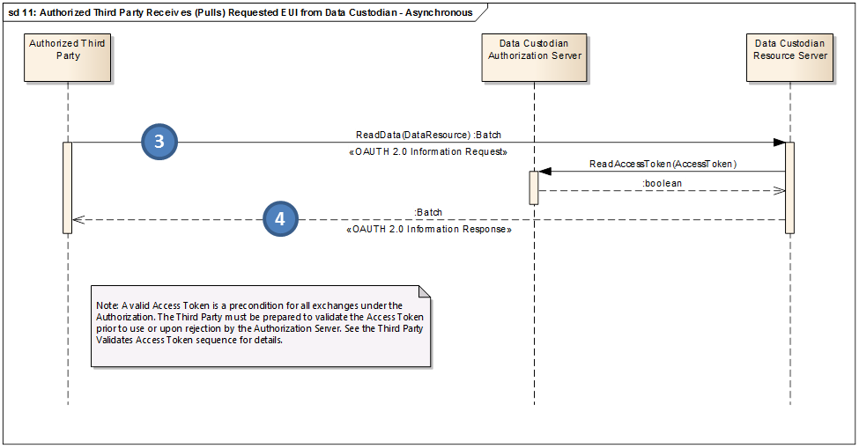
Green Button CMD Data Flows
Authorization: Bearer {client_access_token | {access_token}
Ref: GreenButtonAuthorization.docx: Appendix B
Ref: GreenButtonAuthorization.docx Section 2.2.4

Slide 35
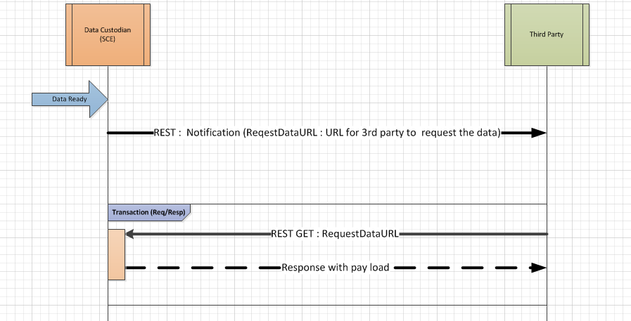
PUSH Model – Notify/Get
Authorization: Bearer {client_access_token | {access_token}
Ref: GreenButtonAuthorization.docx: Appendix B
When data is ready, data custodian will notify third party with Multiple URLS
Third party will make call (GET) based on the URL(s) provided
Data custodian will respond with the data as part of response to GET call
Ref: GreenButtonCDMWorkshop: Slide 16

Slide 36
Notification^{(*no access_token needed)}
DC
TP
Request:
HTTP POST
https://localhost/ThirdParty/espi/1_1/Notification
Content-type: application/xml
Response:
<?xml version="1.0" encoding="UTF-8"?>
<BatchList xmlns="http://naesb.org/espi" xmlns:xsi="http://www.w3.org/2001/XMLSchema-instance" xsi:schemaLocation="http://naesb.org/espi espiDerived.xsd">
<resources>https://localhost:8080/DataCustodian/espi/1_1/resource/Batch/Subscription/1 </resources>
<resources>https://localhost:8080/DataCustodian/espi/1_1/resource/Authorization/1 </resources>
<resources>https://localhost:8080/DataCustodian/espi/1_1/resource/Batch/Bulk/1 </resources>
</BatchList>
Ref: GreenButtonCDMWorkshop: Slide 19

Slide 37
Retrieve UsagePoints for a Subscription
DC
TP
HTTP GET
https://localhost/DataCustodian/espi/1_1/ resource/Subscription/{subscriptionID}/UsagePoint
Content-type: application/atom+xml
Authorization: Bearer {client_access_token | {access_token}]
Ref: GreenButtonAuthorization.docx: Appendix B
Ref: GreenButtonCDMWorkshop: Slide 21

Slide 38
Deferred Response when DC does not have data ready
DC
Request:
HTTP GET
https://localhost/DataCustodian/espi/1_1/Subscription/1
Content-type: application/xml
TP
HTTP returns 202
Request:
HTTP POST
https://localhost/ThirdParty/espi/1_1/Notification
Content-type: application/xml
Request:
HTTP GET
https://localhost/DataCustodian/espi/1_1/Subscription/1
Content-type: application/xml
HTTP returns 200 and Data
Authorization: Bearer {client_access_token | {access_token}]
Ref: GreenButtonAuthorization.docx: Appendix B
ThirdParty makes asynchronous request
DataCustodian does not have the data ready – returns HTTP 202
Some time later (when ready no guarantees or time limit) DataCustodian sends Notification with original URL in BatchList
DataCustodian provides the result
Ref: GreenButtonCDMWorkshop: Slide 17

Slide 39
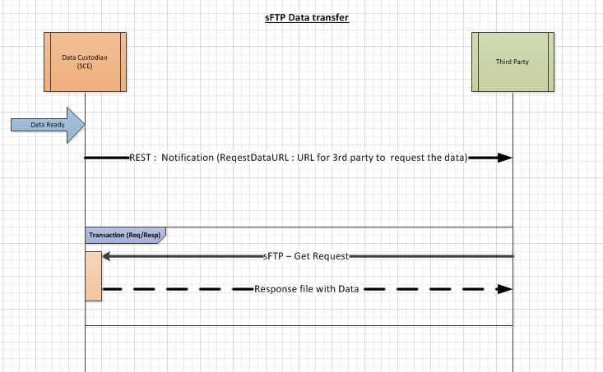
SFTP Data Transfer
Certificate Based Transfer
When data is ready, data custodian will notify third party with Multiple URLS (1)
Third party will make call (sFTP) based on the URL(s) provided
Data custodian will respond with the data as part of response to sFTP get call
Ref: GreenButtonCDMWorkshop: Slide 18

Slide 40
SFTP for Bulk Transfer
Pertinent to the SFTP discussion are the concepts that each Third Party has a defined relationship with the Data Custodian.
For automated exchange of information about his relationship there is a special Authorization obtained in Use Case #1
We anticipate that when the Data Custodian has data available, it sends an asynchronous Notification to the Third Party.
This Notification provides URIs of note that it is assumed the Third Party will want to retrieve.
For the purposes of Bulk transfer, this URI will be:
sftp://hostname:port/DataCustodian/espi/1_1/resource/Batch/Bulk/{bulkId}
where {bulkId} is a unique identifier assigned by the Data Custodian and the balance of the URI is presented in the ApplicationInformation. The Third Party would then retrieve the bulk data by using an SFTP client with that URI.
Used to Retrieve the data SFTP protocols
Discussion –
After authorization of TP, they use Peney test, so what is benefit of access-token?
sftp user:pw, user=<tpname>, password=<tp client-credentials access-token>
Summary
sftp://hostname:port/DataCustodian/espi/1_1/resource/Batch/Bulk/{bulkId}
sftp user:pw, user=<tpname>, password=<tp client-credentials access-token>
Ref: Authorization.docx Section 2.3.2
Ref: GreenButtonCDMWorkshop: Slide 22

Slide 41
Where is More Technical Information
Base Standard
http://www.naesb.org/ESPI_Standards.asp (working version: espiDerived.xsd)
Developer Info
Download My Data - Content, Generation, and Sampleshttps://collaborate.nist.gov/twiki-sggrid/bin/view/SmartGrid/GreenButtonSDK
Open Source (DMD/CMD)
http://energyos.github.io/OpenESPI-GreenButton-API-Documentation/
https://github.com/energyos/OpenESPI-Common-java
https://github.com/energyos/OpenESPI-DataCustodian-java
https://github.com/energyos/OpenESPI-ThirdParty-java
SandBox (alpha)
DataCustodian: https:/services.greenbuttondata.org/DataCustodian
ThirdParty: ThirdParty https:/services.greenbuttondata.org/ThirdParty
Sample Data: https://services.greenbuttondata.org/sample-data.html
API Sandbox: http://energyos.github.io/OpenESPI-GreenButton-API-Documentation/API/
Testing and Certification
Data Validation Self-test tool - http://www.greenbuttondata.org/greentest.aspx
Green Button Test Plan - http://osgug.ucaiug.org/sgsystems/OpenADE/Shared%20Documents/Testing%20and%20Certification/GreenButtonTestPlan/GreenButtonTestPlan.docx

Slide 42

Information for YOU!
Thank You

Slide 43
Definitions
Customer
If residential it is individual (customer of record)
If commercial it is an entity
Customer Account
Organization of the bill
A customer may multiple customer accounts
Service Account/Agreement
Corresponds Customer to a meter
Customer Information Service Request (CISR)
A legal agreement that authorizes a California utility to provide customer information to a thirdparty – paper or online
Service Point/Location
Logical location representing the meter at the premises level
ESPI
RetailCustomer
Owner of one or more UsagePoints (has right to authorize)
Subscription
Authorized access to a (sub) set of UsagePoints of a single RetailCustomer
Bulk
Authorized access to a collection of UsagePoints governed by individual authorizations to a third party

Slide 44
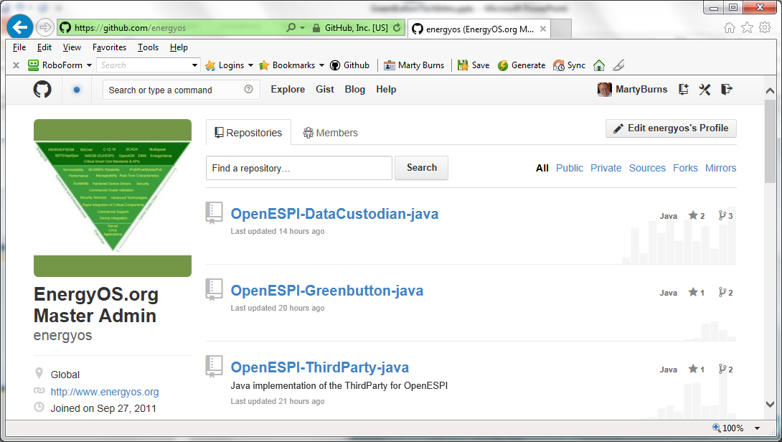
Open Source Green Button https://github.com/energyos

Slide 45
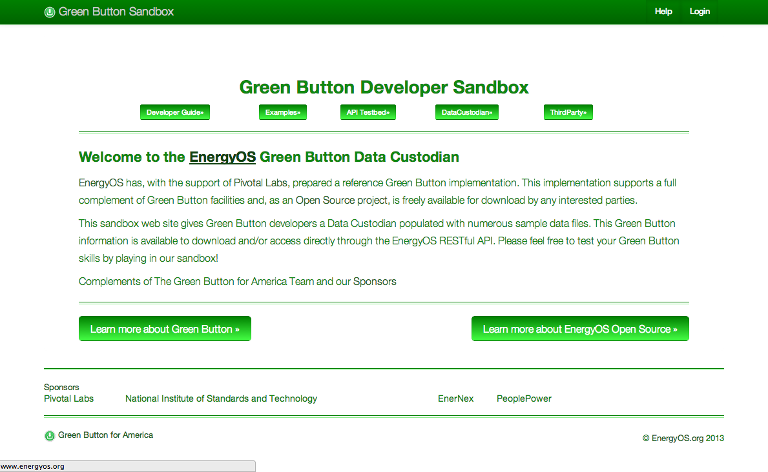
Green Button Connect My Data Sandbox http://services.greenbuttondata.org/

Slide 46
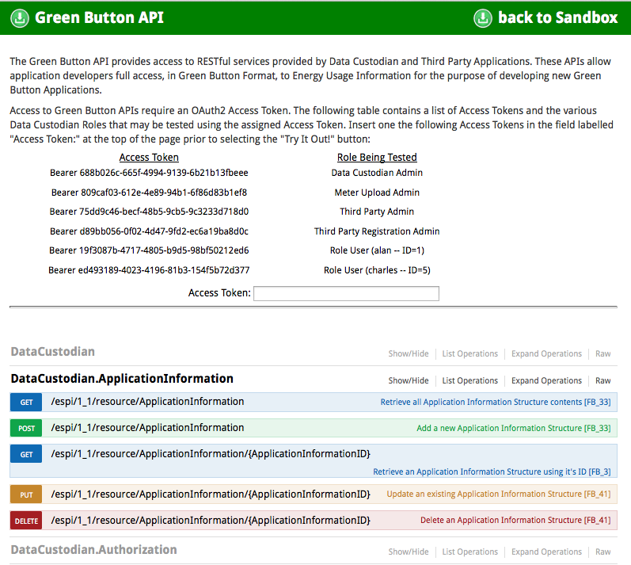
Green Button CMD Live API

